Slide 1



Assistive Technology Service Delivery Outcomes
Rosemarie Cooper, MPT, ATP
Department of Rehabilitation
Science & Technology
Director of CAT

Slide 2
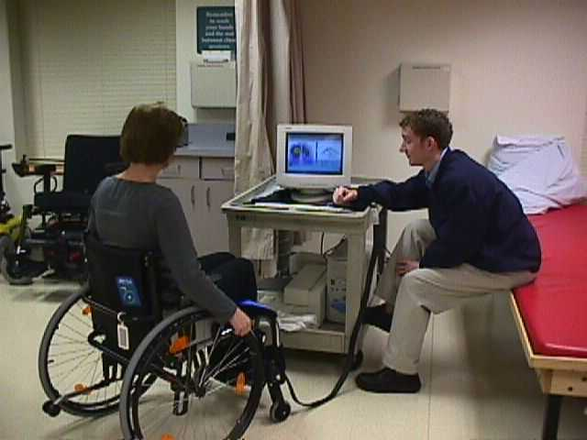
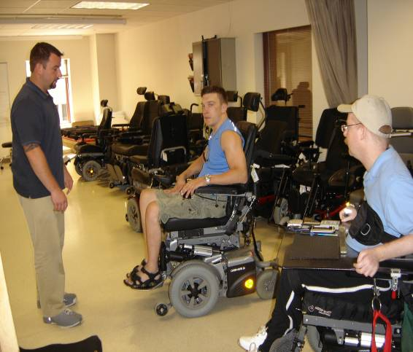
Clinical Challenges
client-centered team evaluation
secure funding
final fitting and training
more complex the technology
more involved
more time consuming the training

Slide 3
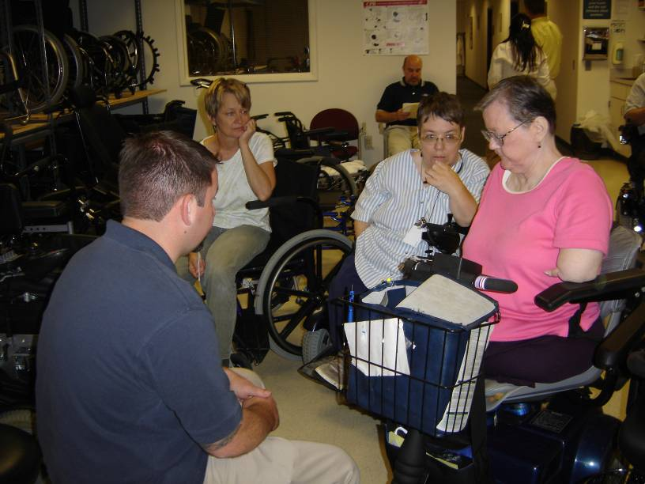
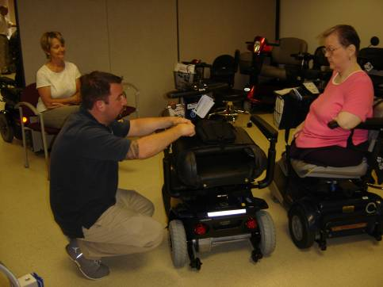
Clinical Challenges
amount of information is too much and sometimes too overwhelming
users forget how to operate more complex the technology
Invest in Training!-failure to invest -may cause harm and injuries
Gives third party payers added reason to cut funding for existing technology.

Slide 4
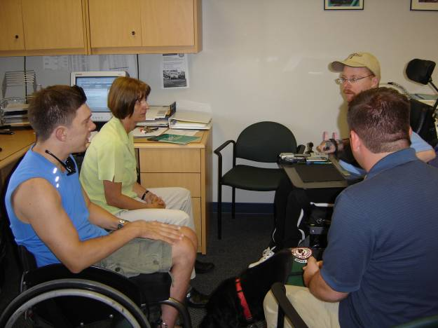
HOW -
do clinicians find time for training
do we know that the education and training is followed through?

Slide 5
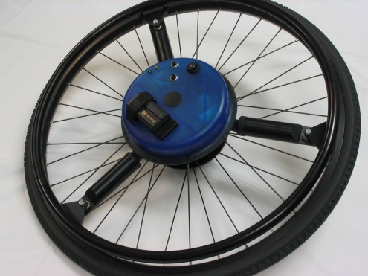
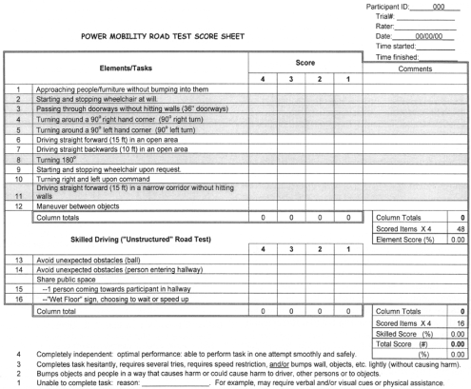

Implementation of Outcome Measure
The Need
Locating the appropriate tool
Integration into assessment
Acceptance by clinicians

Slide 6
The Importance of Quantitative Data
Bolsters funding justification:
  Medical Insurance and Vocational Rehab
Provides data to support equipment decisions
Client education
  Feedback to promote training (e.g., push technique)
Provides visit-to-visit data to track client outcomes
Database and “knowledge base” creation
Notes:
6
What people view as “hard data” goes a long way in justifying equipment. It can also be used to help teach clients. The “knowledge base” creation refers to this: As your local database grows (and the national database grows), knowledge is accumulating not just about individual clients, but also about “what works” (or doesn’t work) for whole groups of clients (SCI, MS, CP, TBI, etc). The database becomes a really valuable source of knowledge.

Slide 7
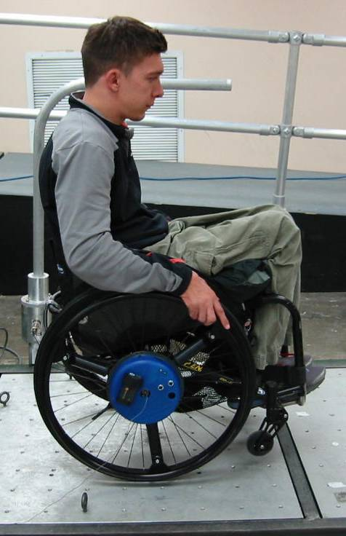

The SmartWheel is a Quantitative Tool
The SmartWheel provides data such as:
  Average force it takes to propel a wheelchair
  Length of each push on the handrim
  How often the person is pushing
  How smooth the person is pushing
Notes:
7
This is really an “overview” slide. More details follow on the following slides.

Slide 8
Functional Mobility Assessment (FMA) TOOL
there are ten items on a scale from 1-6, so the maximum total number one can receive would be 60 (client reports they are 100% satisfied with their current mobility needs in performing wheelchair tasks).
1. Durability, Reliability
2. Comfort
3. Health Needs
4. Operate
5. Reach
Transfers
7. Personal Care
8. Indoor Mobility
9. Outdoor Mobility
10. Transport

Slide 9
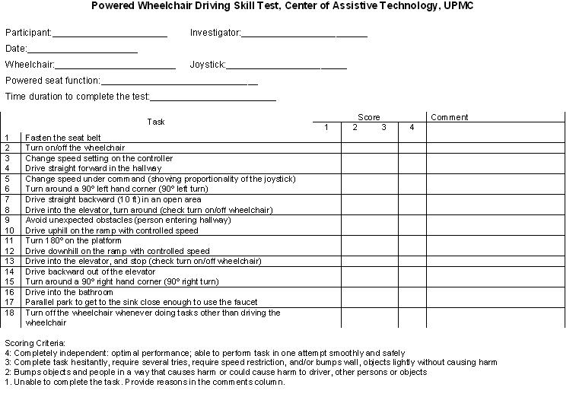

Slide 10
Timed Up & Go (TUG)Test
Sit in Arm Chair
Get up & walk 3 meters
Turn around, come back & sit down
  <10 seconds = normal
  <20 seconds = good mobility, can go out alone, mobile without a gait aid
  <30 seconds= problems , cannot go outside alone , requires a gait aid
    Podsiadio & Richardson, 1991
  ≤ 14 seconds = high risk for falling
    Shumway-Cook, Brauer& Woolcott, 2000)

Slide 11
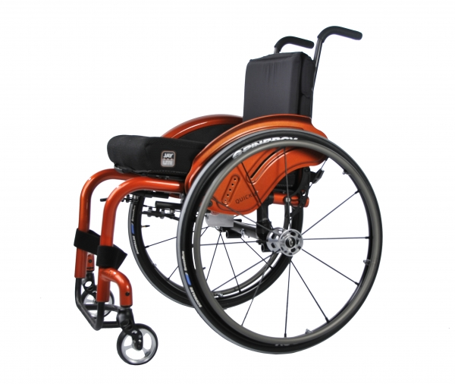
Ultra-light manual Wheelchair Prescription Pattern
Can it be influenced?
Cordelia Wilson, ROTC

Slide 12
Significance
Hypothesis: With the addition of 14”W x 16” D ultra-light rigid wheelchair chair to the available trial equipment, more users, therapists, and suppliers will be influenced with their final decisions to consider and include these smaller frames

Slide 13
Research Design and Methods
Database and medical records housed within the University of Pittsburgh Center for Assistive Technology, of all individuals utilizing an ultra-light wheelchair and was reviewed and incorporated into data analysis.
Data collected of147 ultra-light manual wheelchair prescriptions from 2009 to 2012.
Demographics:
  age, height, weight, and diagnosis
  type of chair and recommended frame size was noted

Slide 14
Ultra-light Wheelchair Prescriptions

Slide 15
Prescription Trends Over Time
Note: Variety of 10-14 models prescribed in 2009 to 2011; 3 models prescribed in 2012

Slide 16
Seat Width Trends
Percentage of </= 14” frames for year: 2009 - 3.3%; 2010 - 12.5% , 2011 - 18% , 2012 - 27.2%

Slide 17
Clients With 14” and Lower Frames
Averages for 22 Clients
Height/Weight Range of Clients |  | Type of Diagnosis
Average Height | 5’2” | Spina Bifida | 9
Average Weight | 116 lbs. | C Injury - SCI | 3
Tallest Client Height | 6’5” | T Injury- SCI | 2
Tallest Client Weight | 172 lbs. | Amputation | 1
Shortest Client Height | 3’0” | Paraplegia | 3
Shortest Client Weight | 52 lbs. | Neurological Progressive | 4
Heaviest Client Height | 5’4”
Heaviest Client Weight | 190 lbs.
Lightest Client Height | 52 lbs.
Lightest Client Weight | 3’0”

Slide 18
Ultra-light End User Population 2009 to 2012
 | 2009 | 2010 | 2011 | Up to May 2012
Total Clients | 30 | 56 | 50 | 11
Average Height | 5’4” | 5’5” | 5’4” | 5’5”
Average Weight | 165 lbs. | 168 lbs. | 156 lbs. | 182 lbs.
Tallest Height | 6’4” | 6’5” | 6’8” | 5'11
Tallest Weight | 200 lbs. | 201 lbs. | 300 lbs. | 230 lbs.
Shortest Height | 3’0” | 4’.5” | 2’9” | 4’3”
Shortest Weight | 52 lbs. | 164 lbs. | 25 lbs. | 70 lbs.
Diagnosis:
Spina Bifida | 9 | 11 | 15 | 2
C injury-SCI | 1 | 4 | 2 | 1
T injury –SCI | 5 | 7 | 9 | 1
Amputation | 0 | 1 | 6 | 1
Paraplegia | 5 | 12 | 6 | 1
Neurological Progressive | 2 | 8 | 6 | 4
Brain Injury/ damage | 6 | 4 | 6 | 0
Other | 2 | 9 | 0 | 1

Slide 19
What Have We Learned?
increased consideration in the prescribing of 14” frames by 3% to 27% regardless of industry trends
Similar demographics, thus 14”W x 16”D was the cause for increased consideration on appropriate demo chairs.

Slide 20
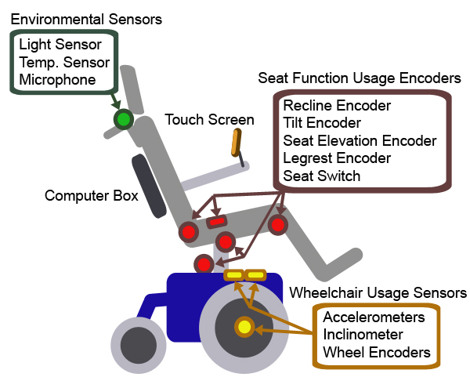
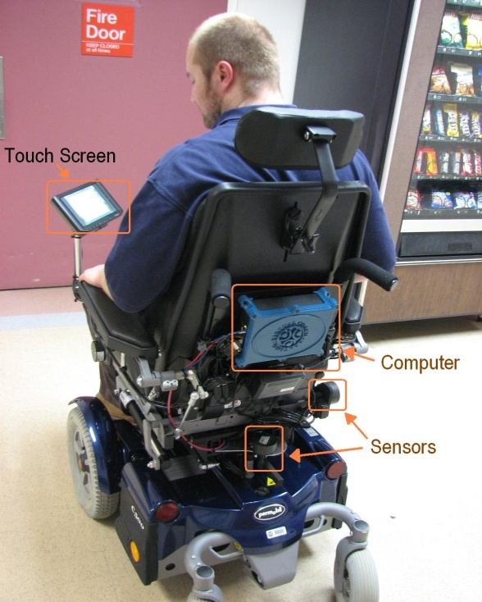
Virtual Seating Coach (VSC)
Functions:
  Monitor and Record
    Power seat function and wheelchair usage
    Interaction with VSC
  Remind
    Pressure relief
    Usage safety
  Report
    For clinicians
Conventional power wheelchair
  Current: instrumented system
  Future: add-on system
Notes:
This is the hardware structure of the virtual coach.
[click] We put a series of sensors and encoders on the wheelchair to monitor and record seat function usage, wheelchair usage, and how the user interacts with virtual coach. The data are stored and process in the computer
[click] the virtual coach will remind the user to perform pressure relief through the touch the screen as the interface, and provide warnings if the seat functions are used inappropriately, such as driving the wheelchair uphill when the seat is tilted backward.
[click] the clinician can pull out the data to review the seat function and wheelchair usage history.
[click] currently the virtual coach system is instrumented on a conventional power wheelchair. It does not affect normal use of the wheelchair. We are developing an add-on system, so that the virtual coach can be more easily to be applied on different models of wheelchairs.

Slide 21
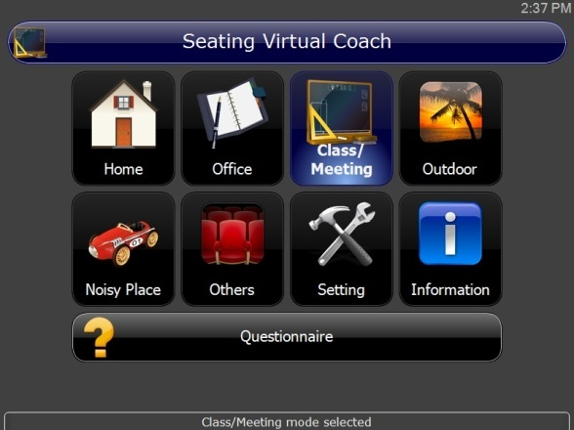
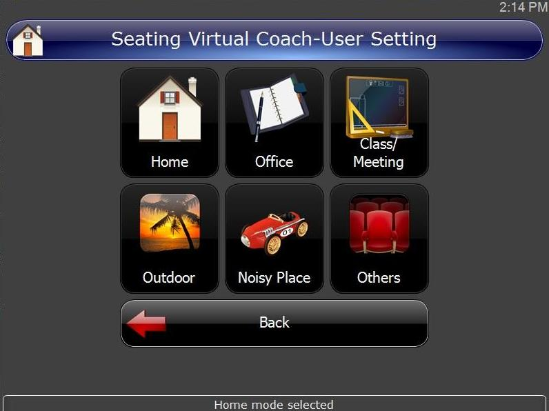
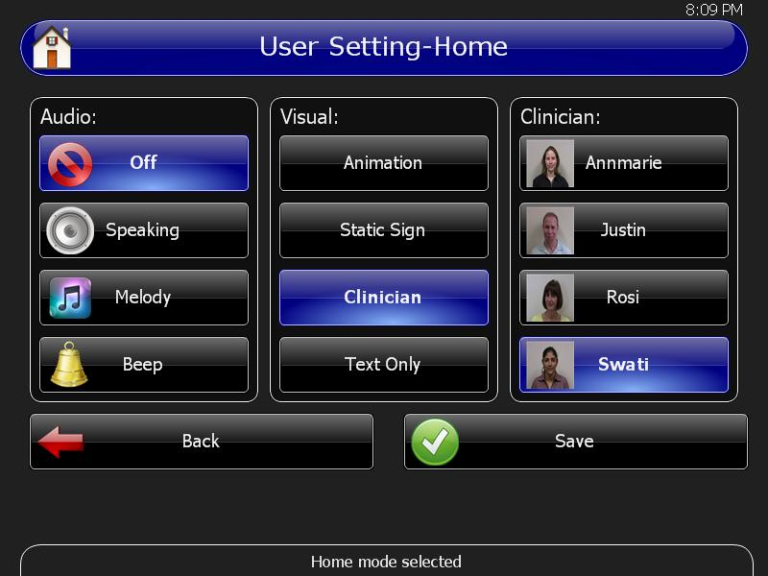
Virtual Seating Coach (VSC)
User can personalize display effects
Desktop page
Notes:
The user can change the display effect by selecting between different modes on the desktop. Each mode is a combination of display effects set for the certain environment.

Slide 22
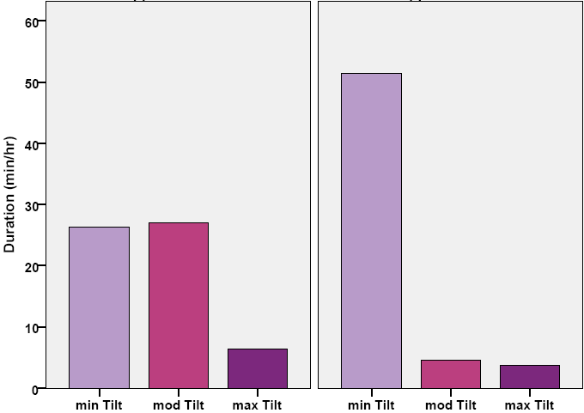
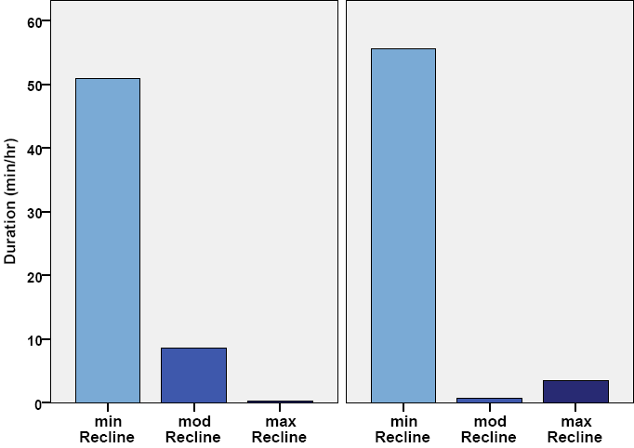
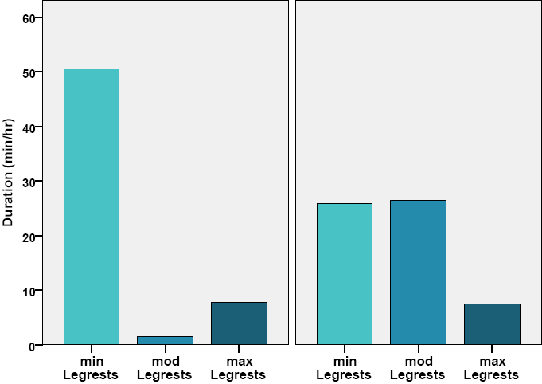
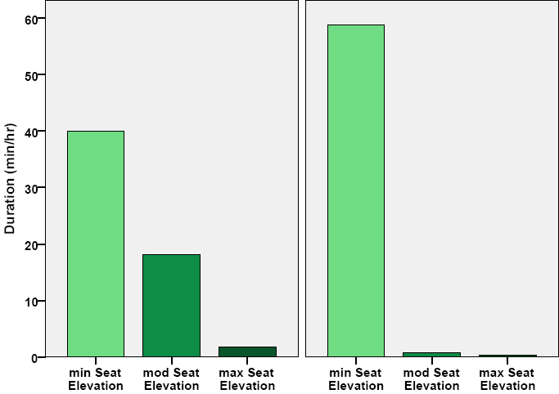
Duration
Limited Upper Limb Function
Good Upper Limb Function
Limited Upper Limb Function
Good Upper Limb Function
Tilt
Recline
Leg Elevation
Seat Elevation
Notes:
Besides, users with limited hand functions spend much less time sitting in a mild tilted position compare to who with good hand functions. Usually wheelchair users with limited hand functions also have weak trunk control or balance, which requires them to sit in a tilted position to increase stability and reduce the demand to maintain sitting posture.
[click] with the data collected by the virtual coach, we can do more analysis on how an experience user uses seat functions. Then we can use the finding to improve wheelchair interface and training protocol.

Slide 23
Quality Measure In Service Delivery of Mobility Devices (RESNA 2009)
  Goal:
      determine how much time is taken for delivery of mobility devices
  Target:
      under 100 days from the initial visit to the final delivery of the mobility device.
  Evaluate:
      How close the target timeline is met
      the efficiency of a service delivery organization

Slide 24
RESULTS
Data collected from 549 cases.
The average total days taken for delivering the mobility device were calculated as 110 .00 +/- 70.11 day.
  52 (9.5%) >/= 50 days
  257 (46.8%) 51-100 days
  153 (9.7%) 101-150 days
  57 (10.4%)151- 200 days
  19 (3.5%) 201- 300 days
  7 (1.3%) 301- 400 days
  5 (1.0%) 401-876 days
Therapist’s time was shortest, followed by vendor’s time, then by insurance’s time.

Slide 25

Thank you
Any Questions????
www.herl.pitt.edu

